Slide 1

Ascent Employee Compass MVP
Transforming HR Management with a modern, scalable platform designed to streamline processes and boost productivity. This presentation covers the problem, solution, key features, technology stack, MVP status, improvements, business impact, roadmap, and conclusion.

Slide 2

Current HR Management Challenges
Manual Processes
Paper-based task assignments
Email chains for progress updates
Spreadsheet tracking systems
Disconnected communication tools
Time Inefficiencies
Hours spent on status meetings
Delayed progress reporting
Duplicate data entry
Manual report generation

Slide 3

Ascent Employee Compass Solution
Unified Platform
Streamlines HR management by integrating tasks, user roles, courses, and notifications.
Key Value Propositions
Improves efficiency, engagement, and communication across HR processes.

Slide 4
Core Features Overview
Task Management
User & Course Management
Notifications & Reports
Create and assign tasks
Real-time notifications
Progress tracking with documentation
Role-based access control
PDF export functionality
Employee profiles and department organization
Deadline and status management
Manage employees very easily & digitally
Department-specific courses

Slide 5
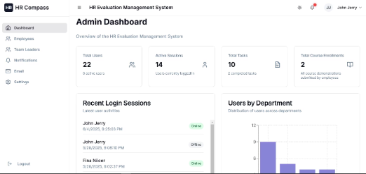
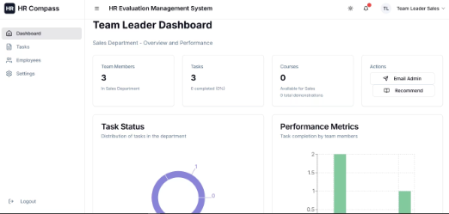
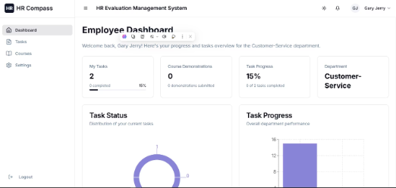
Role-Based Dashboard Experience
Admin Dashboard
Team Leader Dashboard
Employee Dashboard
Manage employees and their login sessions and promote team leaders
Create and assign tasks
View assigned tasks and update progress
Track team progress and manage members
Access courses and track personal goals
System notifications and email management
Department analytics and report export
Receive notifications
Export reports (PDF)

Slide 6
Technology Stack
Frontend Technologies
Backend Technologies
React 18 UI Framework
Python Flask API framework
TypeScript for type safety
MySQL database
Tailwind CSS styling
JWT authentication
Shadcn/UI components
FPDF PDF generation
React Router navigation
EmailJS email integration
Recharts for data visualization
REST API communication

Slide 7

Current MVP Implementation Status
Completed Features
Current Limitations
Authentication System 100%
Limited advanced analytics
Role-based Dashboards 100%
Basic course video player
Task Management 100%
Limited email functionality
User Management 100%
No mobile app
Course System 100%
Limited external integrations
Notifications 100%
PDF Export and Email Integration 100%

Slide 8
Areas for Improvement & Enhancement
High Priority
Advanced Analytics: Real-time KPI tracking
1
Push Notifications: Browser and mobile
Advanced Search: Global task/user search
Mobile App: Native iOS/Android apps
Medium Priority
Workflow Automation: Auto-task assignments
2
Enhanced Video Player: Interactive features
Integration APIs: Slack, Teams, Google
Advanced Reporting: Custom report builder
Future Enhancements
3
Technical improvements and enterprise integrations to scale the platform.

Slide 9
Business Impact & ROI
75%
+40%
Admin Time Saved
Task Completion Increase
10x
+60%
Reporting Speed Improvement
Employee Engagement Boost
Total cost savings of $85K per year from manual processing, meeting optimization, and paper reduction.

Slide 10


Meet the Ascent Team
Team Member 1
Team Member 2
Team Member 3
Lead Developer driving the technical vision and implementation.
Product Manager overseeing feature prioritization and user experience.
UX Designer crafting intuitive interfaces and workflows.

